Slide 1
Symphony of the Scriptures
Nahum
Notes:
Introduction: The book of Nahum can easily be divided into three sections which coincide with the three chapters: Nineveh’s doom declared (chapter 1), Nineveh’s doom described (chapter 2), Nineveh’s doom deserved (chapter 3).
Nineveh’s doom declared (1) - The reason for destruction
A. The character and power of the Lord. 1. God’s vengeance, even though He is slow to anger (1:1-3) 2. The fierceness of His anger described (1:3b-6) 3. The goodness of the Lord, as a stronghold to the faithful (1:7). 4. The pursuer of His enemies (1:8).
B. The complete overthrow of Nineveh.
1. She will not afflict again, despite her plotting against the Lord (1:9-11)
2. Judah will be delivered from Nineveh’s affliction (1:12-13)
3. Nineveh’s destruction has been commanded by the Lord (1:14)
4. There shall be good tidings in Judah, she can keep her feasts (1:15)
Nineveh’s doom described (2) - The means of destruction A. The siege and capture of the city
1. Furious preparation for the battle is described (2:1-4) 2. Resistance is futile, captivity has been decreed (2:5-7) a. Note verse 6: “The gates of the rivers are opened, and the palace is dissolved” b. “The Babylonian Chronicle tells that Nineveh fell because the flooding rivers made breaches in the city’s defenses.” (Believers’ Study Bible) B. The utter sack of the city
1. Her inhabitants flee, the city is plundered (2:8-10)
2. Her destruction will be complete, Nineveh as a dwelling of devouring lions will be no more (2:11-13)
Nineveh’s doom deserved (3) - the justification and certainty of destruction
A. Because of her sins.
1. Her woe will be due to her sins (Nah 3:1-4)
2. The Lord will uncover her shame and make her a spectacle (3:5-7) B. She is no better than No-Amon 1. Nineveh is no better than No-Amon (Thebes in Egypt) (3:8) 2. Who despite her strength, was carried away into captivity (3:9-10)
3. So it will be with Nineveh (3:11) C. Her strength and wealth will not save her. 1. Her strongholds will fail - (3:12-13) 2. All her efforts, her wealth, her army, will be futile (3:14-17) D. Her end has come
1. Her leaders are dead, her people scattered (3:18-19a) 2. Those who hear of her fall will rejoice (3:19b)
Conclusion - No relief for Assyria. Doom come “at last” is a good way to describe this book. The last stanza of “Almost Persuaded” is fitting: “Almost Persuaded, harvest is past! Almost persuaded, doom comes at last! Almost cannot avail; Almost is but to fail; Sad, sad, thaty bitter wail ---Almost --- but lost!
The message of Nahum for the people of God is one of consolation (as his name reflects). That those who afflict God’s people will be judged (1:2-3; cf. Lk 18:7-8b).
That God is a stronghold in time of trouble (1:7; cf. Ps 27:5) Are you trusting in God as your Stronghold?
The message of Nahum for those who do evil is one of warning
Don’t rely on what mercy was shown to your ancestors (e.g., as in the days of Jonah)
The Lord may be merciful and slow to anger, but the day of judgment does finally come!-
Are you trusting in what your parents or ancestors may have done, to escape the judgment of God? This message of Nahum is reminiscent of the words of Paul: “Therefore consider the goodness and severity of God: on those who fell, severity; but toward you, goodness, if you continue in His goodness. Otherwise you also will be cut off.” (Ro 11:22)
Note: The important theme of Nahum is “At Last….Judgment comes.” The story of Jonah is about Nineveh. Around 770 BC (about 150 years earlier than Nahum), Nineveh had repented and had been spared. However, Nineveh had returned to violence and cruelty. “At last” God did to Nineveh what He had purposed to do in Jonah’s day. “The Lord is slow to anger and great in power” (1:3a), but eventually He will destroy the wicked. He ”will by no means leave the guilty unpunished” (1:3b). The book therefore teaches that, “though it sometimes appears that evil is stronger than righteousness, the justice of the Lord will ultimately prevail” --- Coy Roper, Truth for Today Commentary (2), page 241.
Theological question: Reading 2:13; 3:5, is God against us? Or is He for us? (Ro. 8:31). Which is it? The answer is not dependent on God, but on us: “Whoever wishes to be a friend of the world makes himself God’s enemy” (Ja. 4:4). Jesus says, “He who is not with Me is against Me” (Mt. 12:30). The choice is really ours.

Slide 2
Nahum
Circa 630 BC
“Consolation” or “Comforter”
Prophesying
to Nineveh –
Notice the absence of
an offer for
repentance;
announcing
only judgment.
The Character and
Power of God
The Judgment
of God
Nineveh’s impending doom decreed by the Lord
Details of Nineveh’s downfall
Predicated and described
Justified and defended
Inevitable and inescapable
The goodness and severity of God
Chapter
1
Chapters
2-3
Emphasis
The majestic character of our sovereign
God qualifies Him to be Judge over all.
Nineveh’s willful and heartless decline
Justifies the judgment of Almighty God
Theme
The impending doom of Nineveh, capital of Assyria
Key Verses
“And the Lord will be no means leave the guilty unpunished.” (1:3b)
“Woe to the bloody city.” (3:1)
Christ in
Nahum
Christ will judge the nations, freeing His people once and for all from their enemies
Notes:
At the same time Jeremiah and Zephaniah (Habakkuk was a later contemporary) were pronouncing judgment against Judah, another prophet was directing his attention at one of her enemies (Assyria). The Book of Nahum begins with these words: “An oracle (burden, KJV) concerning Nineveh. The book of the vision of Nahum of Elkosh” (1:1). From this passage we learn all we know of Nahum and his background. The book was written some 150 years after Jonah’s work in Assyria (760 BC) and 100 years after Assyria had taken Israel into captivity (722 BC, 2 Kings 17). It was written while Assyria was the most powerful nation in the ancient Near East which lasted for about 200 years. History tells us that Assyria was defeated by the Babylonians and the Medes in 612 BC (completed in 605 BC), at which time Babylon became the great power of the region. The references by Nahum to Nineveh, the capital city, are meant to include all the nation of Assyria. The singular message of Nahum is the destruction of Nineveh (Assyria) and to provide assurance to Judah that her enemies would be judged. Like Jonah and Obadiah, it was primarily written about what would happen to a sinful nation other than Judah or Israel (God’s covenant people). The destruction of Nineveh is presented in vivid terms (3:1-4). Nahum describes them as a “bloody city,” “full of lies and plunder,” and its people “betrays nations with her whorings (harlotry), and peoples with her charms (sorcery).” If any city deserved destruction for its mistreatment of others, Nineveh certainly did! Not only does Nahum predict their destruction, but implies that the fall of the city would bring satisfaction and comfort to others: “All who hear the news about you clap their hands over you. For upon whom has not come your unceasing evil?” (3:19). The destruction of Nineveh in 612 BC was so complete that the site of Nineveh was not identified until AD 1845. My opinion is that the book ‘s intention was to show God’s people that the nations that had plundered them would soon be destroyed (as with Edom). Therefore, just as Nahum’s name means “comfort” so would God’s judgment against oppressing nations bring consolation to God’s people. Of Judah, Nahum encourages them to keep her feasts and faithful worship (1:14-15). Most divide the book into two parts: A hymn about God in chapter 1 and a description of the fall of Nineveh in chapters 2 and 3. There will be no relief for Nineveh: “There is no easing your hurt; your wound is grievous” (3:19a).
Application - The nature of God (1:2-6).
God is a God of wrath (1:2): He is a “jealous” and “avenging” God. As a “wrathful” God He will not leave the guilty unpunished: “In flaming fire, inflicting vengeance on those who do not obey” (1 Th. 1:8a).
God is slow to anger (1:3): God had showed Himself to be merciful when He did not destroy Nineveh during Jonah’s time proving that He is slow to anger (see Jonah 4:2).
God is powerful (1:3b): He has power over all nature, nations and people. When God decides to destroy a a nation, nothing can prevent that from happening. No one “can stand before His indignation” or “endure the burning of His anger” (1:6).
God is both loving and vengeful. Paul speaks pf the “goodness and the severity of God” (Ro. 11:22). We need to recognize both sides of God’s character. Nahum says God is “slow to anger” but ”will not leave the guilty go unpunished” (1:3). Justice demands it.
God distinguishes between His friends and enemies (1:7-8). God is “good” but His goodness is shown to His friends, whereas He will destroy those who are His enemies. Jesus says, “Who is not with Me is against Me” (Mt. 12:30). Every person is either a friend or an enemy: there is a broad way or narrow way (Mt. 7:13-14); either we are on His right hand or His left (Mt. 25:34-35). Jesus says we are His friend if we obey His commandments (15:14). There is no in between.
God’s judgment is sure (3:1-12). Nahum uses Thebes (No-amon) as an example of the false security one can erroneously feel but God’s judgment will come against unrighteousness is a certainty. Nineveh would be cut down and destroyed; she would not escape judgment (3:11-15). For us, failure to repent and obey will result in our separation from God.
Key thought: God will not excuse sinful behavior; not with Nineveh, and not with us. “For if we go on sinning deliberately after receiving the knowledge of the truth, there no longer remains a sacrifice for sins, 27 but a fearful expectation of judgment, and a fury of fire that will consume the adversaries….29 How much worse punishment, do you think, will be deserved by the one who has trampled underfoot the Son of God, and has profaned the blood of the covenant by which he was sanctified, and has outraged the Spirit of grace? 30 For we know him who said, “Vengeance is mine; I will repay.” And again, “The Lord will judge his people.” 31 It is a fearful thing to fall into the hands of the living God” (Heb. 10:26-31).

Slide 3
Period | History Covered | Scriptures | Years | Principal
Antediluvian | Creation to the Flood | Gen. 1-7 | 1656 | Adam
Postdiluvian | From the flood to call of Abraham | Gen. 8-!1 | 427 | Noah
Patriarchal | From the call of Abraham to Egyptian Bondage | Gen. 12-45 | 215 | Abraham
Egyptian Bondage | From Egyptian Bondage to the Exodus | Gen. 46-Ex. 11 | 215 | Joseph
Wilderness Wanderings | From Exodus to crossing of the Jordan | Ex. 12-Deut. 34 | 40 | Moses
Conquest of Canaan | From crossing of Jordan to Joshua’s death | Josh. 1-24 | 51 | Joshua
Judges | From Joshua to King Saul | Ju, Ruth, 1 Sa. 1-9 | 305 | Samuel
The United Kingdom | From origin of kingdom to its division | 1 Sa. 9-1 Ki. 11; 1 Chr. 10, 2 Chr. 9 | 120 | David
The Divided Kingdom | From the division to the fall of Israel | 1 Ki. 12-2 Ki. 20; 2 Chr. 10-32 | 253 | Elijah
Judah Alone | From fall of Israel to the fall of Judah | 2 Ki. 21-25; 2 Chr. 10-32 | 125 | Josiah
Babylonian Captivity | From the fall of Judah to the return | 2 Ki. 25-8- 21; Dan. 1-6; Ezekiel | 70 | Daniel, Ezekiel
Restoration of the Jews | From the return to end of OT history | Ezra, Nehemiah | 92 | Ezra
Between the Testaments | From end of OT to the beginning of the NT | None | 400 | Judas Maccabe
Life of Christ | From birth of Jesus to ascension | Mt-Jhn 21; Acts1 | 34 | Jesus
The Church | From ascension to death of Paul (96 AD approx.) | Acts 2-Revelation | 70 | Paul

Slide 4
Times of the prophets
Exile:
Jeremiah, Daniel, Ezekiel
United Kingdom:
Moses, Deborah, Samuel, Nathan, Gad, Zadok, Heman, Asaph, Jeduthun, Ahijah
Divided Kingdom
Northern Kingdom:
Jehu, Elijah, Micaiah,
Elisha, Jonah, Amos,
Hosea
Divided Kingdom
Southern Kingdom:
Shemaiah, Iddo, Azariah, Obadiah, Joel, Isaiah, Micah, Nahum, Habakkuk, Zephaniah, Jeremiah
Restoration(Post-exilic)
Haggai, Zechariah,
Malachi
There are four major prophets: Isaiah, Jeremiah (Lamentations), Ezekiel, & Daniel
There are twelve minor prophets: Hosea, Joel, Amos, Obadiah, Jonah, Micah, Nahum, Habakkuk, Zephaniah, Haggai, Zechariah, & Malachi.

Slide 5
CHRONOLOGY OF PROPHETS
9th Century
Prophets
Assyrian Exile - Israel 722 BC
Babylonian Exile- Judah 586
8th Century
Prophets
7th and 6TH
Century
Prophets
Exilic
Prophets
Postexilic
Prophets
Jonah
Amos
Hosea
Haggai
Zechariah
Malachi
Israel
Fall of
Nineveh
612 BC
Daniel
Ezekiel
Obadiah
(early date)
Joel
Nahum
Isaiah
Zephaniah
Habakkuk
Jeremiah
Obadiah
(late date)
Judah
Isaiah
Micah
Major prophets in bold, italics

Slide 6
Jonah
760 BC
Nahum
630 BC
Minor
Prophets
Timeline
Nineveh
612 BC
Fall of
Nineveh
Amos
755 BC
Hosea
750 BC
Israel
722
BC
Divided
Kingdom
930 BC
586 BC
536 BC
Judah Exile Return
Joel
830 BC
Micah
735 BC
Zephaniah
630 BC
Habakkuk
612 BC
Haggai
Zechariah
520 BC
Malachi
445 BC
Obadiah
845 BC
Obadiah
586 BC
Early date
Late date
Edom
575 BC - Edom crushed by Babylon

Slide 7
Introduction - Nahum
”This prophet belonged to the same period as Zephaniah and Jeremiah. We may assume that his date was not far from 625 B.C....The word Nahum means compassion. Some students claim that his home was on the banks of the Tigris River, others that he came from southwest Judah. Still others think he was from Galilee, a native of Capernaum (City of Nahum). Nahum’s hatred for the cruel Assyrians (Nineveh) can be detected in almost every sentence of his book. A holy and just God could not let this city live. His righteous indignation flashes like lightning in poetic utterances...Nineveh mocked God and died. Such teaching is not inconsistent with the holiness of God.” --- Hester, Heart of Hebrew Nation, page 289

Slide 8
Who wrote the book?
The only mention in Scripture of Nahum the Elkoshite occurs in the first verse of his own book. While scholars have proposed a number of theories about Nahum’s hometown, Elkosh, but no one really knows the location. Some say the best option identifies it with a city in southern Judah that later came to be known as Elcesi, near where the prophet Micah lived. Nahum’s prophecy against the city of Nineveh would have been significant for the people of Judah, who would have needed encouragement in the face of the terrifying power of the Assyrian Empire. Nothing else is known about Nahum

Slide 9
Where are we?
The book of Nahum mentions the recent fall of No-amon, or Thebes, which occurred in 663 BC (Nahum 3:8), as well as the coming destruction of Nineveh, which happened in 612 BC (1:1; 3:11–15). But when, during this more than fifty-year period, did Nahum preach? The Assyrian Empire, which had its capital at Nineveh, was at its most powerful in the first half of this period, having a stranglehold on Judah during King Manesseh’s reign (2 Chr. 33:10–13). The date of Nahum’s prophecy was likely between 663 and 612 B.C.
Nahum preached during the reign of King Manesseh, one of the most evil kings in Judah’s long history, a man who needed the pain of his own experience to teach him the lessons of being a good king. That means Nahum preached during the darkest period in Judah’s history to that point, a time filled with idolatry of all kinds in a nation that had completely turned its back on God. The Lord’s willingness to send Nahum, whose name means “consolation” or “comfort,” into such a hopeless situation evidences His unrelenting and overwhelming grace.

Slide 10
Why is Nahum so important?
Nahum’s singular focus on the impending judgment of Nineveh offers a continuation of the story that began in Jonah. Sometime around 760 BC, God sent Jonah to Nineveh to preach repentance and hope to the Assyrian people, a message they heard and adopted—at least for a time. One hundred years later, during the time of Nahum, the Assyrians had returned to their bullish ways, conquering the northern kingdom of Israel and lording their power over Judah in the south (2 Ki. 17:1–6; 18:13–19:37). Jonah failed to realize what Nahum reminded the people of Judah: God’s justice is always right and always sure. Should He choose to grant mercy for a time, that good gift will not compromise the Lord’s ultimate sense of justice for all in the end.
The book differs from from many of the other prophets in two ways: (1) It neither rebuked Juda for their sins nor required them to repent. (2) It was (like Obadiah and Jonah, but unlike the other prophets) primarily written about what would happen to a nation other than God’s chosen people.

Slide 11
What's the point?
After allowing approximately two hundred years of powerful Assyrian kings and rulers, God announced through Nahum His plans to judge the city of Nineveh (again). While the book as a whole clearly shows God’s concern over sin, His willingness to punish those guilty of wickedness, and His power to carry out His desire for judgment, it also contains rays of hope shining through the darkness. Most significant, the people of Judah would have immediately taken hope in the idea that Nineveh, their primary oppressor for generations, would soon come under judgment from God. One can almost hear their whispers, “it’s about time!” Also, a small but faithful remnant in an increasingly idolatrous Judah would have been comforted by declarations of God’s slowness to anger (Nahum 1:3), His goodness and strength (1:7), and His restorative power (2:2).
Not only did Nahum predict Nineveh’s destruction, but he also indicated tha the fall of the city would bring comfort to others. In fact, no one would grieve at the downfall of the “bloody city” ---- “full of lies and pillage” (3:1-9).

Slide 12
How do I apply this?
Ever felt disgusted about our nation’s depravity? We ask, “How long will God put up with this?” No doubt we all have felt overwhelmed by the darkness both within ourselves and in our world. Nahum lived in a dark time, a time in which the faithful few must have wondered how long they would have to resist cultural and spiritual compromise.
Have you ever found your will to do what’s right weakening as you became discouraged with what you saw in your life and in the world around you? The prophet Nahum reminds us of God’s active hand, working even in the darkest of times to bring justice and hope throughout the world.

Slide 13
Character of God
Chapter 1
Even thought He is slow to anger, God will take vengeance.
Nahum 1:2-3 God is jealous, and the LORD avenges; The LORD avenges and is furious. The LORD will take vengeance on His adversaries, and He reserves wrath for His enemies; The LORD is slow to anger and great in power, and will not at all acquit the wicked.
God's anger is fierce.
Nahum 1:5-6 The mountains quake before Him, The hills melt, and the Earth heaves at His presence, yes, the world and all who dwell in it. Who can stand before His indignation? And who can endure the fierceness of His anger? His fury is poured out like fire, and the rocks are thrown down by Him.
The goodness of the Lord is a stronghold to the faithful.
Nahum 1:7 The LORD is good, A stronghold in the day of trouble; and He knows those who trust in Him.
(All scripture quotes from NKJV)

Slide 14
Character of God
Chapter 1
God will pursue his enemies to an end.
Nahum 1:8 But with an overflowing flood He will make an utter end of its place, and darkness will pursue His enemies.
Despite her plotting against the Lord, Nineveh will be completely overthrown. She will not afflict anyone again.
Nahum 1:9-10 What do you conspire against the LORD? He will make an utter end of it. Affliction will not rise up a second time. For while tangled like thorns, and while drunken like drunkards, they shall be devoured like stubble fully dried.
The Ninevites are evil counselors, plotting evil against Judah, the Lord’s people. Although they appear safe, they will be destroyed.
Nahum 1:11-12 From you comes forth one who plots evil against the LORD, a wicked counselor. Thus says the LORD: "Though they are safe, and likewise many, yet in this manner they will be cut down when he passes through.”

Slide 15
Character of God
Chapter 1
Nahum 1:11-12 From you comes forth one who plots evil against the LORD, a wicked counselor. Thus says the LORD: "Though they are safe, and likewise many, yet in this manner they will be cut down when he passes through.”
Adam Clarke says the wicked counselor is Sennacherib, king of Assyria and that the “one who passes through” was the death angel.
Sennacherib invaded Judea with an army of nearly 200,000 men in 681 BC. Yet, 2 Kings 19 says an angel of the Lord slew 185,000 of them in one night.
2 Kings 19:35 And it came to pass on a certain night that the angel of the LORD went out, and killed in the camp of the Assyrians one hundred and eighty-five thousand; and when people arose early in the morning, there were the corpses - all dead.
This would require Nahum to have issued this prophesy before 681 BC, but in Chapter 3 Nahum mentions the prior destruction of the city of Thebes (No-Amon) in Egypt, which history says happened in 663 BC.

Slide 16
Character of God
Chapter 1
Judah will be delivered from Nineveh’s affliction.
Nahum 1:13 Though I have afflicted you, I will afflict you no more; for now I will break off his yoke from you, and burst your bonds apart."
Nineveh’s destruction has been commanded by the Lord.
Nahum 1:14 The LORD has given a command concerning you: "Your name shall be perpetuated no longer. Out of the house of your gods I will cut off the carved image and the molded image. I will dig your grave, for you are vile."
There shall be good tidings in Judah and she can keep her feasts, as the wicked counselor has been cut off.
Nahum 1:15 Behold, on the mountains, the feet of him who brings good tidings, who proclaims peace! O Judah, keep your appointed feasts, perform your vows. For the wicked one shall no more pass through you; he is utterly cut off.

Slide 17
Nahum
Circa 630 BC
“Consolation” or “Comforter”
Prophesying
to Nineveh –
Notice the absence of
an offer for
repentance;
announcing
only judgment.
The Character and
Power of God
The Judgment
of God
Nineveh’s impending doom decreed by the Lord
Details of Nineveh’s downfall
Predicated and described
Justified and defended
Inevitable and inescapable
The goodness and severity of God
Chapter
1
Chapters
2-3
Emphasis
The majestic character of our sovereign
God qualifies Him to be Judge over all.
Nineveh’s willful and heartless decline
Justifies the judgment of Almighty God
Theme
The impending doom of Nineveh, capital of Assyria
Key Verses
“And the Lord will be no means leave the guilty unpunished.” (1:3b)
“Woe to the bloody city.” (3:1)
Christ in
Nahum
Christ will judge the nations, freeing His people once and for all from their enemies
Notes:
At the same time Jeremiah and Zephaniah (Habakkuk was a later contemporary) were pronouncing judgment against Judah, another prophet was directing his attention at one of her enemies (Assyria). The Book of Nahum begins with these words: “An oracle (burden, KJV) concerning Nineveh. The book of the vision of Nahum of Elkosh” (1:1). From this passage we learn all we know of Nahum and his background. The book was written some 150 years after Jonah’s work in Assyria (760 BC) and 100 years after Assyria had taken Israel into captivity (722 BC, 2 Kings 17). It was written while Assyria was the most powerful nation in the ancient Near East which lasted for about 200 years. History tells us that Assyria was defeated by the Babylonians and the Medes in 612 BC (completed in 605 BC), at which time Babylon became the great power of the region. The references by Nahum to Nineveh, the capital city, are meant to include all the nation of Assyria. The singular message of Nahum is the destruction of Nineveh (Assyria) and to provide assurance to Judah that her enemies would be judged. Like Jonah and Obadiah, it was primarily written about what would happen to a sinful nation other than Judah or Israel (God’s covenant people). The destruction of Nineveh is presented in vivid terms (3:1-4). Nahum describes them as a “bloody city,” “full of lies and plunder,” and its people “betrays nations with her whorings (harlotry), and peoples with her charms (sorcery).” If any city deserved destruction for its mistreatment of others, Nineveh certainly did! Not only does Nahum predict their destruction, but implies that the fall of the city would bring satisfaction and comfort to others: “All who hear the news about you clap their hands over you. For upon whom has not come your unceasing evil?” (3:19). The destruction of Nineveh in 612 BC was so complete that the site of Nineveh was not identified until AD 1845. My opinion is that the book ‘s intention was to show God’s people that the nations that had plundered them would soon be destroyed (as with Edom). Therefore, just as Nahum’s name means “comfort” so would God’s judgment against oppressing nations bring consolation to God’s people. Of Judah, Nahum encourages them to keep her feasts and faithful worship (1:14-15). Most divide the book into two parts: A hymn about God in chapter 1 and a description of the fall of Nineveh in chapters 2 and 3. There will be no relief for Nineveh: “There is no easing your hurt; your wound is grievous” (3:19a).
Application - The nature of God (1:2-6).
God is a God of wrath (1:2): He is a “jealous” and “avenging” God. As a “wrathful” God He will not leave the guilty unpunished: “In flaming fire, inflicting vengeance on those who do not obey” (1 Th. 1:8a).
God is slow to anger (1:3): God had showed Himself to be merciful when He did not destroy Nineveh during Jonah’s time proving that He is slow to anger (see Jonah 4:2).
God is powerful (1:3b): He has power over all nature, nations and people. When God decides to destroy a a nation, nothing can prevent that from happening. No one “can stand before His indignation” or “endure the burning of His anger” (1:6).
God is both loving and vengeful. Paul speaks pf the “goodness and the severity of God” (Ro. 11:22). We need to recognize both sides of God’s character. Nahum says God is “slow to anger” but ”will not leave the guilty go unpunished” (1:3). Justice demands it.
God distinguishes between His friends and enemies (1:7-8). God is “good” but His goodness is shown to His friends, whereas He will destroy those who are His enemies. Jesus says, “Who is not with Me is against Me” (Mt. 12:30). Every person is either a friend or an enemy: there is a broad way or narrow way (Mt. 7:13-14); either we are on His right hand or His left (Mt. 25:34-35). Jesus says we are His friend if we obey His commandments (15:14). There is no in between.
God’s judgment is sure (3:1-12). Nahum uses Thebes (No-amon) as an example of the false security one can erroneously feel but God’s judgment will come against unrighteousness is a certainty. Nineveh would be cut down and destroyed; she would not escape judgment (3:11-15). For us, failure to repent and obey will result in our separation from God.
Key thought: God will not excuse sinful behavior; not with Nineveh, and not with us. “For if we go on sinning deliberately after receiving the knowledge of the truth, there no longer remains a sacrifice for sins, 27 but a fearful expectation of judgment, and a fury of fire that will consume the adversaries….29 How much worse punishment, do you think, will be deserved by the one who has trampled underfoot the Son of God, and has profaned the blood of the covenant by which he was sanctified, and has outraged the Spirit of grace? 30 For we know him who said, “Vengeance is mine; I will repay.” And again, “The Lord will judge his people.” 31 It is a fearful thing to fall into the hands of the living God” (Heb. 10:26-31).

Slide 18
Judgment of God
Chapter 2
Nineveh’s doom described: The furious preparation for battle is detailed. The siege begins.
Nahum 2:1-4 ¹ He who scatters has come up before your face. Man the fort! Watch the road! Strengthen your flanks! Fortify your power mightily. ² For the LORD will restore the excellence of Jacob like the excellence of Israel, for the emptiers have emptied them out and ruined their vine branches. ³ The shields of his mighty men are made red, the valiant men are in scarlet. The chariots come with flaming torches in the day of his preparation, and the spears are brandished. ⁴ The chariots rage in the streets, they jostle one another in the broad roads; They seem like torches, they run like lightning.
Resistance is futile; Captivity for Nineveh has been decreed.
Nahum 2:6-7 The gates of the rivers are opened, and the palace is dissolved. It is decreed: She shall be led away captive; She shall be brought up; And her maidservants shall lead her as with the voice of doves, beating their breasts.

Slide 19
Nineveh is now called upon to prepare for the approach of her enemies, the instruments of Jehovah's vengeance, and the military array and muster, the very arms and dress, of the Medes and Babylonians in the reigns of Cyaxares and Nabopolassar; their rapid approach to the city; the process of the siege, and the inundation of the river; the capture of the palace; the captivity, lamentation, and flight of the inhabitants; the sacking of this immense, wealthy, and exceedingly populous city; and the consequent desolation and terror, are all described in the pathetic, vivid, and sublime imagery of Hebrew poetry in verses 2-10.
-- Adam Clarke

Slide 20
Judgment of God
Chapter 2
Nineveh’s doom described: The siege and sack of the city. Once a powerful city, her inhabitants flee and she is plundered. (612 BC)
Nahum 2:8-10 ⁸ Though Nineveh of old was like a pool of water, now they flee away. "Halt! Halt!" they cry; but no one turns back. ⁹ Take spoil of silver! Take spoil of gold! There is no end of treasure, or wealth of every desirable prize. ¹⁰ She is empty, desolate, and waste! The heart melts, and the knees shake; Much pain is in every side, and all their faces are drained of color.
Nahum 2:13 "Behold, I am against you," says the LORD of hosts, "I will burn your chariots in smoke, and the sword shall devour your young lions; I will cut off your prey from the Earth, and the voice of your messengers shall be heard no more."
Her destruction will be complete, Nineveh as a dwelling place of devouring lions will be no more.

Slide 21
About the fall of Nineveh - 1
“Nahum foretold of the certain downfall of Nineveh, the capital of Assyria. Her city walls would be destroyed from the flooding of the Tigris River (2:6). Nineveh was not concerned about this because her walls were 50 feet thick and 100 feet high. History records that for a period of three months the Babylonian army used battering rams to weaken the walls. A great rain came and and the Tigris River flooded, collapsing a weakened section of the wall. Through this breach, the Babylonians entered the city to burn and utterly destroy it. This is the fulfillment of God’s prophecy that the walls would be destroyed and that the Babylonian army came through like “an overflowing flood” (1:8)…The message was clear and encouraging to Judah. The Lord would bring judgement upon sinful Nineveh but would spare Judah … Nineveh’s destruction was so complete that the site of the city was forgotten … Nineveh stood as a grave of ruins until it was first explored by C.J. Rich in A.D. 1820 and excavated for the first time by Paul Botta in 1824.”
Note: Quote taken from Nancy Fink’s book on the Minor Prophets, page 56. Her
information came from two sources: Halley’s Handbook, page 370; “Nineveh,”
Major Cities of the Biblical World, by M.R. Wilson and R.K. Harrison.

Slide 22
About the fall of Nineveh - 2
Note again verse 6: “The gates of the rivers are opened, and the palace is dissolved” Babylonian chronicles tells that Nineveh fell because the flooding rivers made breaches in the city’s defenses. But Greek history also records it. The following account is given by ancient Greek historian Diodorus Siculus (c. 90 – 20 BC):
"There was a prophecy received from their forefathers, that Nineveh should not be taken till the river first became an enemy to the city. It happened in the third year of the siege, that the Euphrates (s/b Tigris) being swollen with continued rains, overflowed part of the city, and threw down twenty stadia of the wall. The king (Sardanapalus) then imagining that the oracle was accomplished, and that the river had now manifestly become an enemy to the city, casting aside all hope of safety, and lest he should fall into the hands of the enemy, built a large funeral pyre in the palace, and having collected all his gold and silver and royal vestments, together with his concubines and eunuchs, placed himself with them in a little apartment built in the pyre; burnt them, himself, and the palace together. When the death of the king was announced by certain deserters, the enemy entered in by the breach which the waters had made, and took the city."
Thus the prophecy of Nahum was literally fulfilled: "the gates of the river were opened, and the palace dissolved," i.e., burnt. -- Adam Clarke

Slide 23
Judgment of God
Chapter 3
The justification for Nineveh’s doom. Her “woe” will be directly a result of her sins.
Nahum 3:1-4 ¹ Woe to the bloody city! It is all full of lies and robbery. Its victim never departs. ² The noise of a whip and the noise of rattling wheels, of galloping horses, of clattering chariots! ³ Horsemen charge with bright sword and glittering spear. There is a multitude of slain, a great number of bodies, countless corpses - They stumble over the corpses - ⁴ Because of the multitude of harlotries of the seductive harlot, the mistress of sorceries, who sells nations through her harlotries, and families through her sorceries.
The Lord will uncover her shame and make her a spectacle.
Nahum 3:5-7 ⁵ "Behold, I am against you," says the LORD of hosts; "I will lift your skirts over your face, I will show the nations your nakedness, and the kingdoms your shame. ⁶ I will cast abominable filth upon you, make you vile, and make you a spectacle. ⁷ It shall come to pass that all who look upon you will flee from you, and say, 'Nineveh is laid waste! Who will bemoan her? Where shall I seek comforters for you?"

Slide 24
Judgment of God
Chapter 3
Nineveh is no better than No-Amon (Thebes in Egypt) who despite her strength, was carried away into captivity. Thebes had been sacked in 663 BC by Ashurbanipal, king of Assyria.
Nahum 3:8-10 ⁸ Are you better than No Amon that was situated by the river, that had the waters around her, whose rampart was the sea, whose wall was the sea? ⁹ Ethiopia and Egypt were her strength, and it was boundless; Put and Lubim were your helpers. ¹⁰ Yet she was carried away, she went into captivity; Her young children also were dashed to pieces at the head of every street; They cast lots for her honorable men, and all her great men were bound in chains.
As with No-Amon, so it will be with Nineveh.
Nahum 3:11 You also will be drunk; You will be hidden; You also will seek refuge from the enemy.

Slide 25
Judgment of God
Chapter 3
Nineveh’s strength and wealth will not save her. Her strongholds will fail. All her efforts, her wealth, her army, will be futile.
Nahum 3:12-15 ¹² All your strongholds are fig trees with ripened figs: If they are shaken, they fall into the mouth of the eater. ¹³ Surely, your people in your midst are women! The gates of your land are wide open for your enemies; Fire shall devour the bars of your gates. ¹⁴ Draw your water for the siege! Fortify your strongholds! Go into the clay and tread the mortar! Make strong the brick kiln! ¹⁵ There the fire will devour you, the sword will cut you off; It will eat you up like a locust. Make yourself many - like the locust!
But, even if she make her armies as numerous as locust, her generals and commanders will abandon their posts and run away.
Nahum 3:17 Your commanders are like swarming locusts, and your generals like great grasshoppers, which camp in the hedges on a cold day; When the sun rises they flee away, and the place where they are is not known.

Slide 26
Judgment of God
Chapter 3
Nineveh’s end has come. Her leaders are dead, her people scattered.
Nahum 3:18 Your shepherds slumber, O king of Assyria; Your nobles rest in the dust. Your people are scattered on the mountains, and no one gathers them.
Nahum 3:19 Your injury has no healing, your wound is severe. All who hear news of you will clap their hands over you, for upon whom has not your wickedness passed continually?
There is no healing possible. Those who hear of her fall will rejoice.
Nineveh did not continue the good resolutions made 130 years earlier during Jonah’s time. They relapsed, increased in wickedness, and Nahum was sent to prophesy of the fall of Nineveh and the end of the Assyrian kingdom.
Babylon destroyed Nineveh in 612 BC. The final fall of the Assyrian Kingdom occurred at the battle of Carchemish in 605 BC as prophesied about in Nahum and in Ezekiel chapter 30.

Slide 27
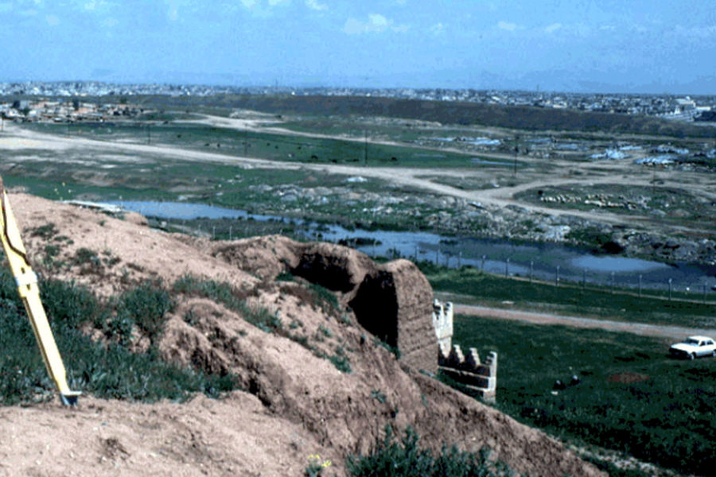
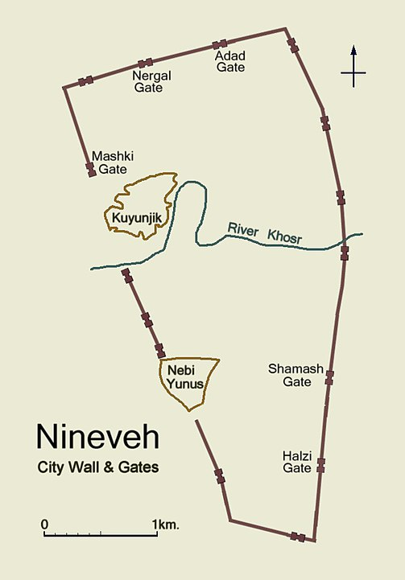
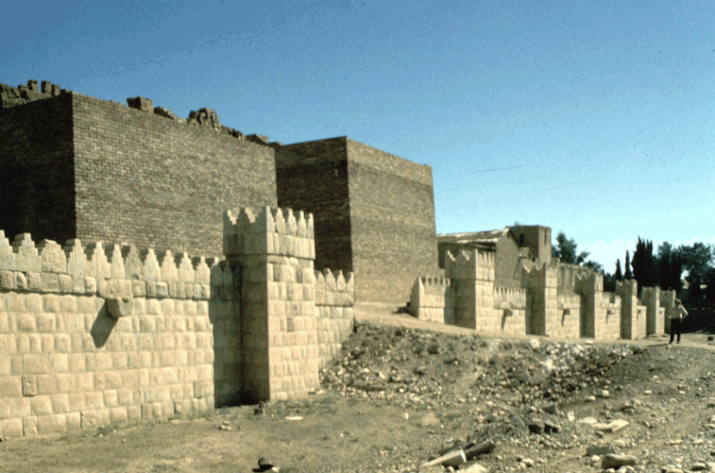
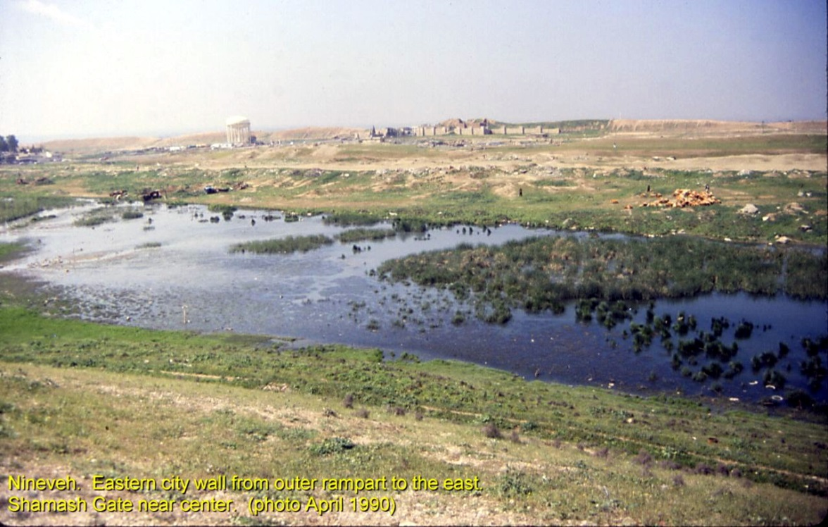
Nineveh archeological site - near modern Mosel
Shamash gate - east (reconstructed)

Slide 28
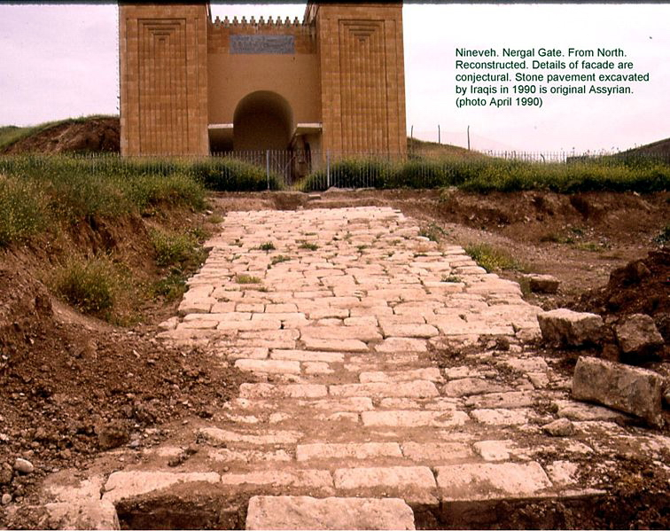
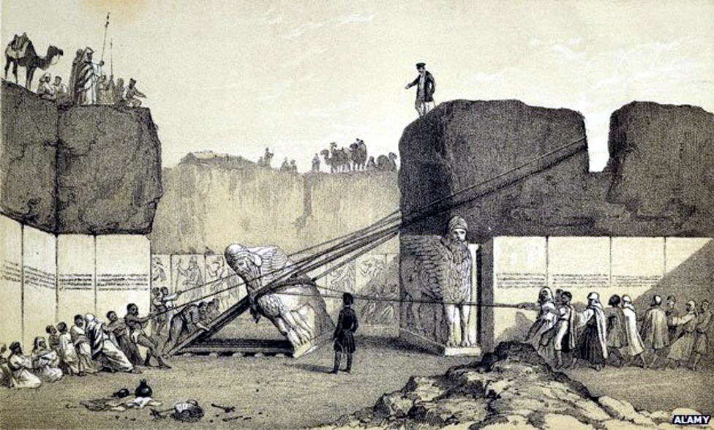
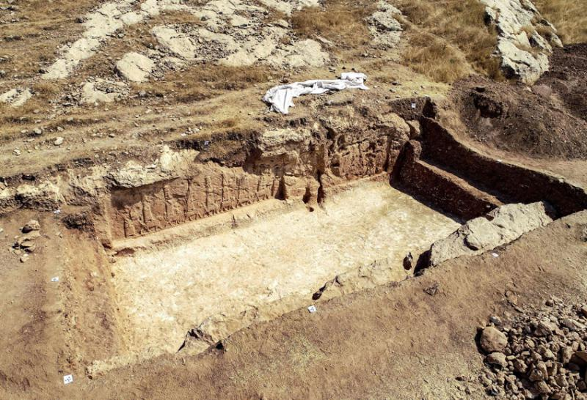
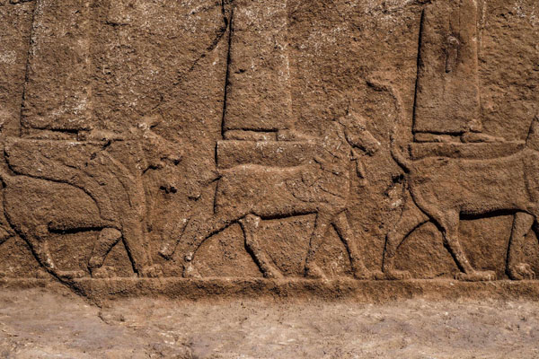
Nineveh excavations in the 1920’s
Recent (2019) excavations of a carved wall dating to the time of Sargon (c 722 BC – 705 BC)

Slide 29
Final thoughts
The theme of Nahum is “At Last …. Judgment will come.”
The story of Jonah is about Nineveh 130 years before Nahum - around 760 BC. We learned that Nineveh had repented and had been spared.
However, these years later, Nineveh had returned to violence and cruelty.
“At last” God did to Nineveh what He had purposed to do in Jonah’s day. “The Lord is slow to anger and great in power” (Nah 1:3a), but eventually He will destroy the wicked. He ”will by no means leave the guilty unpunished” (1:3b). The book therefore teaches that, “though it sometimes appears that evil is stronger than righteousness, the justice of the Lord will ultimately prevail” --- Coy Roper, Truth for Today.
Theological question:
Reading 2:13; 3:5, (“Behold, I am against you," says the LORD of hosts.) Is God against us? Or is He for us? (Rom 8:31 If God is for us, who can be against us?). Which is it?
The answer is not dependent on God, but on us: “Whoever wishes to be a friend of the world makes himself an enemy of God” (James 4:4). Jesus says, “He who is not with Me is against Me” (Matt. 12:30). The choice is really ours.

Slide 30
Conclusion
God will not excuse sinful behavior; not with Nineveh, and not with us:
Nahum 1:2-3a God is jealous, and the LORD avenges; The LORD avenges and is furious. The LORD will take vengeance on His adversaries, and He reserves wrath for His enemies; The LORD is slow to anger and great in power, and will not at all acquit the wicked.
Heb 10:26-31 ²⁶ For if we sin willfully after we have received the knowledge of the truth, there no longer remains a sacrifice for sins,
²⁷ but a certain fearful expectation of judgment, and fiery indignation which will devour the adversaries. ²⁸ Anyone who has rejected Moses' law dies without mercy on the testimony of two or three witnesses. ²⁹ Of how much worse punishment, do you suppose, will he be thought worthy who has trampled the Son of God underfoot, counted the blood of the covenant by which he was sanctified a common thing, and insulted the Spirit of grace? ³⁰ For we know Him who said, "Vengeance is Mine, I will repay," says the Lord. And again, "The LORD will judge His people.“ ³¹ It is a fearful thing to fall into the hands of the living God.

Slide 31
Nahum
Circa 630 BC
“Consolation” or “Comforter”
Prophesying
to Nineveh –
Notice the absence of
an offer for
repentance;
announcing
only judgment.
The Character and
Power of God
The Judgment
of God
Nineveh’s impending doom decreed by the Lord
Details of Nineveh’s downfall
Predicated and described
Justified and defended
Inevitable and inescapable
The goodness and severity of God
Chapter
1
Chapters
2-3
Emphasis
The majestic character of our sovereign
God qualifies Him to be Judge over all.
Nineveh’s willful and heartless decline
Justifies the judgment of Almighty God
Theme
The impending doom of Nineveh, capital of Assyria
Key Verses
“And the Lord will be no means leave the guilty unpunished.” (1:3b)
“Woe to the bloody city.” (3:1)
Christ in
Nahum
Christ will judge the nations, freeing His people once and for all from their enemies
Notes:
At the same time Jeremiah and Zephaniah (Habakkuk was a later contemporary) were pronouncing judgment against Judah, another prophet was directing his attention at one of her enemies (Assyria). The Book of Nahum begins with these words: “An oracle (burden, KJV) concerning Nineveh. The book of the vision of Nahum of Elkosh” (1:1). From this passage we learn all we know of Nahum and his background. The book was written some 150 years after Jonah’s work in Assyria (760 BC) and 100 years after Assyria had taken Israel into captivity (722 BC, 2 Kings 17). It was written while Assyria was the most powerful nation in the ancient Near East which lasted for about 200 years. History tells us that Assyria was defeated by the Babylonians and the Medes in 612 BC (completed in 605 BC), at which time Babylon became the great power of the region. The references by Nahum to Nineveh, the capital city, are meant to include all the nation of Assyria. The singular message of Nahum is the destruction of Nineveh (Assyria) and to provide assurance to Judah that her enemies would be judged. Like Jonah and Obadiah, it was primarily written about what would happen to a sinful nation other than Judah or Israel (God’s covenant people). The destruction of Nineveh is presented in vivid terms (3:1-4). Nahum describes them as a “bloody city,” “full of lies and plunder,” and its people “betrays nations with her whorings (harlotry), and peoples with her charms (sorcery).” If any city deserved destruction for its mistreatment of others, Nineveh certainly did! Not only does Nahum predict their destruction, but implies that the fall of the city would bring satisfaction and comfort to others: “All who hear the news about you clap their hands over you. For upon whom has not come your unceasing evil?” (3:19). The destruction of Nineveh in 612 BC was so complete that the site of Nineveh was not identified until AD 1845. My opinion is that the book ‘s intention was to show God’s people that the nations that had plundered them would soon be destroyed (as with Edom). Therefore, just as Nahum’s name means “comfort” so would God’s judgment against oppressing nations bring consolation to God’s people. Of Judah, Nahum encourages them to keep her feasts and faithful worship (1:14-15). Most divide the book into two parts: A hymn about God in chapter 1 and a description of the fall of Nineveh in chapters 2 and 3. There will be no relief for Nineveh: “There is no easing your hurt; your wound is grievous” (3:19a).
Application - The nature of God (1:2-6).
God is a God of wrath (1:2): He is a “jealous” and “avenging” God. As a “wrathful” God He will not leave the guilty unpunished: “In flaming fire, inflicting vengeance on those who do not obey” (1 Th. 1:8a).
God is slow to anger (1:3): God had showed Himself to be merciful when He did not destroy Nineveh during Jonah’s time proving that He is slow to anger (see Jonah 4:2).
God is powerful (1:3b): He has power over all nature, nations and people. When God decides to destroy a a nation, nothing can prevent that from happening. No one “can stand before His indignation” or “endure the burning of His anger” (1:6).
God is both loving and vengeful. Paul speaks pf the “goodness and the severity of God” (Ro. 11:22). We need to recognize both sides of God’s character. Nahum says God is “slow to anger” but ”will not leave the guilty go unpunished” (1:3). Justice demands it.
God distinguishes between His friends and enemies (1:7-8). God is “good” but His goodness is shown to His friends, whereas He will destroy those who are His enemies. Jesus says, “Who is not with Me is against Me” (Mt. 12:30). Every person is either a friend or an enemy: there is a broad way or narrow way (Mt. 7:13-14); either we are on His right hand or His left (Mt. 25:34-35). Jesus says we are His friend if we obey His commandments (15:14). There is no in between.
God’s judgment is sure (3:1-12). Nahum uses Thebes (No-amon) as an example of the false security one can erroneously feel but God’s judgment will come against unrighteousness is a certainty. Nineveh would be cut down and destroyed; she would not escape judgment (3:11-15). For us, failure to repent and obey will result in our separation from God.
Key thought: God will not excuse sinful behavior; not with Nineveh, and not with us. “For if we go on sinning deliberately after receiving the knowledge of the truth, there no longer remains a sacrifice for sins, 27 but a fearful expectation of judgment, and a fury of fire that will consume the adversaries….29 How much worse punishment, do you think, will be deserved by the one who has trampled underfoot the Son of God, and has profaned the blood of the covenant by which he was sanctified, and has outraged the Spirit of grace? 30 For we know him who said, “Vengeance is mine; I will repay.” And again, “The Lord will judge his people.” 31 It is a fearful thing to fall into the hands of the living God” (Heb. 10:26-31).

